Slide 1
Florida Department of Business and Professional Regulation

Slide 2
History of the Florida Building Code
Naranja Lakes in South Dade. Left, just after Hurricane Andrew in 1992. Right, Mandarin Lakes on the same site, 2017.
Miami Herald File

Slide 3
History:
Prior to 1974 – Adoption of codes and standards was the sole responsibility of the local governments.
1974 –Act establishing Chapter 553, Florida Statutes, setting forth the State Minimum Building Codes approved for use in Florida.
State responsibility – selecting and adopting the allowable minimum codes for Florida, but with no responsibility for the administration of those codes.
Building codes and regulations developed, amended, administered, and enforced by local jurisdictions.
1980 - Florida Energy Code for Building Construction mandated by the legislature as a state uniform code.
1992 - Hurricane Andrew “Experience” – revealed the deficiencies of the State’s existing building code compliance and enforcement process.

Slide 4
History cont.:
1996 - Governor Chiles established the Governor’s Building Codes Study Commission for the purpose of evaluating the building code system and providing recommendations to reform and improve the building code system, if found necessary.
Recommendations/Foundations:
Adopt a single building code for use statewide called the “Florida Building Code”.
Creation of an independent “Board/Commission” to update and maintain the Florida Building Code.
The Code should be administered, interpreted, and enforced by local governments.
Provide means to strengthen compliance and enforcement.
Provide for cost-effective and affordable product evaluation and approval process.
1998 - Legislature adopted the Study Commission’s recommendations (HB 4181).
March 1, 2002 – The first edition of the Florida Building Code went into effect, superseding all local building codes.

Slide 5
Present Building Code System:
Administered By: Florida Building Commission/Building Codes and Standards
Single Statewide Code – Florida Building Code
Incorporating all building standards adopted by all enforcement agencies and state agencies
Supported by: Chapter 553 F.S. and enforced by local governments
Improved training and education program
Statewide Product Approval Program
Procedure for Interpretation (declaratory statement, binding interpretation, non-binding interpretation, etc.)
Procedures for updating and amending the FBC
Research Program
Note: Purpose to generate consistency in code requirements throughout the State

Slide 6
Florida Building Commission
Composed of 27 members – appointed by the governor
Architects, engineers, contractors, fire protection, building officials, product manufacturers, insurance industry representatives, public education representatives, green building representatives
Chair – Mr. Richard Browdy, President, Browdy & Browdy Inc., Jacksonville, FL
Meets every 6 weeks – Across the state

Slide 7
Commission Responsibilities
Adopt and update the Florida Building Code (FBC)
Issue interpretation of the FBC through declaratory statements
Adopt / update the Florida Accessibility Code
Approve applications for waivers of Florida specific accessibility requirements
Approve advanced training courses
Approve products for statewide use as applicable

Slide 8
Commission Organization

Slide 9
Codes and Standards-How we work
Technical support to the Florida Building Commission, Technical Advisory Committees (TACs), Program Oversight Committees (POCs) and Work Groups
Provide technical assistance on the FBC to consumers and local governments
Oversee the code change process
Administer State Product Approval Program

Slide 10
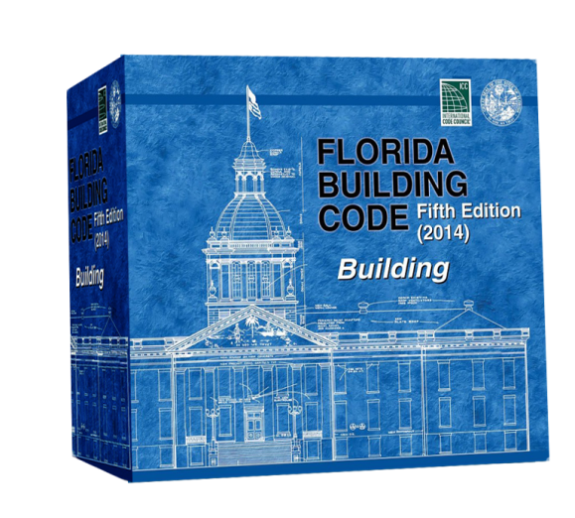
Two Major State Codes
1. Florida Building Code
FS 553.73 - Rule 61G20-1.001
2. Florida Fire Prevention Code-
FS 633 - Rule 69A-60
Administered by the State Fire Marshall

Slide 11
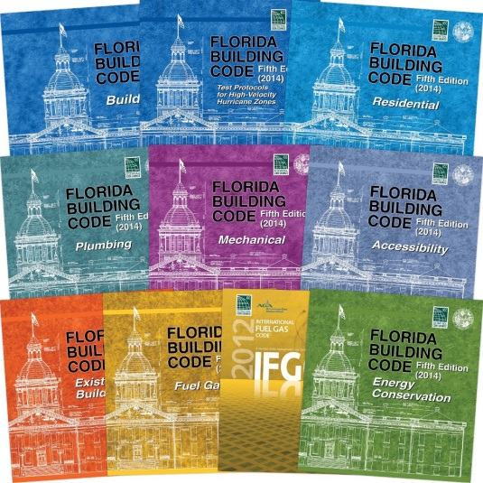
Florida Building Code Status
5th Edition (2014) FBC
Took Effect June 30, 2015
Current Code
Foundation:
2012 I-code
2011 NEC
6th Edition (2017) Florida Building Code
Effective Date December 31, 2017
Foundation
2015 I-Code
2014 NEC

Slide 12
Florida Building Code, Intent (Section 101.3)
The purpose of this code is to establish the minimum requirements to safeguard the public health, safety and general welfare through structural strength, means of egress facilities, stability, sanitation, adequate light and ventilation, energy conservation, and safety to life and property from fire and other hazards attributed to the built environment and to provide safety to fire fighters and emergency responders during emergency operations.

Slide 14
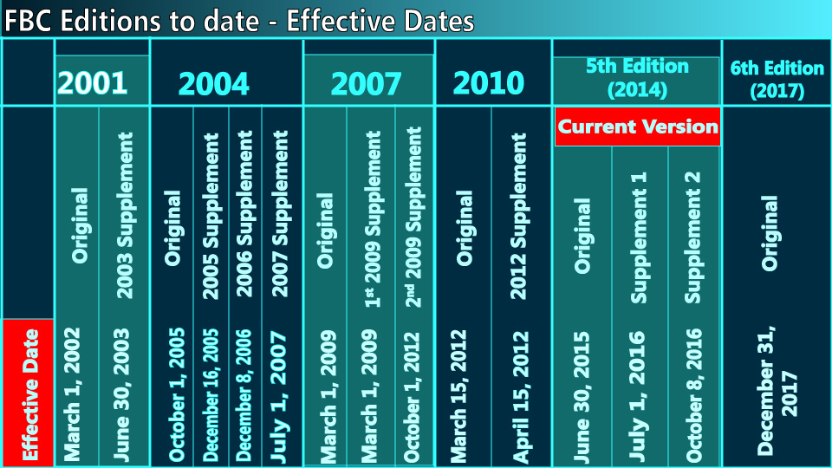

Slide 15
Methods for Code Compliance
Prescriptive provisions /standards (minimum requirements)
Performance compliance provisions/standards
Alternative options for design/flexibility
Alternative materials, design and methods of construction and equipment for consideration of new technology and design systems

Slide 16
General Notes:
The Florida Building Code provides for the following:
Unified Statewide Building Code pertaining to all aspects of construction in Florida
Minimum requirements to ensure that buildings in wind-borne debris areas are protected
Most current national wind protection standards and material standards
Provide for latest edition of the National Electrical Code
Minimum flood protection provisions consistent with the latest flood protection requirements of the National Flood Insurance Program
Energy efficiency standards for buildings that meet the national energy standards as mandated by Title II of the Energy Conservation and Protection Act
Maintain coordination with the Florida Fire Prevention Code
Minimum accessibility standards for buildings consistent with the 2010 ADA Standards for Accessible Design
Effective Building Code System – Rated number 2 in the country by the Insurance Institute for Business and Home Safety (IBHS)

Slide 17
Code Change Process Overview
Triennial
Annual
Glitch

Slide 18
Triennial Update
Current Code, prior Codes and 2017 FBC
IBC
I-CODES
PUBLISHED
Preliminary Supplement +
I-Codes
3 Month –
Public Submits Modification Proposals
1st 45-Day
Public Comment Period
553.73(3)(a) FS
Draft Supplement
Final Review
TAC/Commission
2nd 45-Day
Public Comment Period
TAC Review
Commission Selects I Code
6
7
1
2
5
8
4
9
3

Slide 19
Glitch Code Change Process Section 553.73 (8) and Chapter 120 Florida Statutes - Rulemaking Process
Conflicts within the Florida Building Code
Conflicts between the Florida Building Code and the Florida Fire Prevention Code
Equivalency of Standards
Unintended results from the integration of previously adopted amendments
Changes to federal or state law
Updates to the National Electrical Code

Slide 20
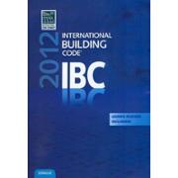
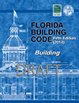
Code Printing Integration 6th Edition (2017) FBC
3 Year Cycle
• FBC Florida specific requirements
• HVHZ (Miami-Dade and Broward counties) requirements
• Special Occupancy— state rules and statutes
• Correlation requirements with the Florida Fire Prevention Code
Florida Specific Requirement
Glitch
6th Edition (2017) FBC
2015 IBC

Slide 21
Code Printing Integration 7th Edition (2020) FBC
Florida Supplement (9/19/2019)
Integrated (4/20/2020)
Rulemaking Hearing (6/8/2020)
Code takes effect no sooner than 6 months after publication
Effective Date (12/31/2020)
Review
+
Original
Glitch
2017 FBC
15 months
7th Edition (2020) FBC
3 Year - ~41 Month Cycle

Slide 22
Code amendment questions regarding fiscal and other impacts:
Impact to local entity relative to enforcement of code
Impact to building and property owners relative to cost of compliance with code
Impact to industry relative to the cost of compliance with code
Impact to small business relative to the cost of compliance with code
Has a reasonable and substantial connection with health, safety and welfare of the general public
Strengthens or improves the code, and provide equivalent or better products, methods, or system of construction
Does not discriminate against materials, products, methods, or systems of construction of demonstrated capabilities
Does not degrade the effectiveness of the code

Slide 23
QUESTIONS?
Codes and Standards – Department of Business and Professional Regulation

