Slide 2
Our most sacred obligation is caring for Veterans, their families, caregivers, and survivors. As a nation, may we always give them our very best.

Slide 3
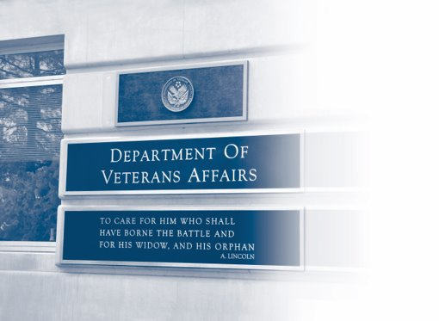
VA Mission
To fulfill President Lincoln's promise: "To care for him who shall have borne the battle, and for his widow, and his orphan" by serving and honoring the men and women who are America's Veterans.

Slide 4
VA Core Values
Our core values focus our minds on our mission of caring and thereby guide our actions toward service to others.
Integrity - Commitment - Advocacy - Respect - Excellence

Slide 5
Defining ICARE
Integrity: Act with high moral principle. Adhere to the highest professional standards. Maintain the trust and confidence of all with whom I engage.
Commitment: Work diligently to serve Veterans and other beneficiaries. Be driven by an earnest belief in VA's mission. Fulfill my individual responsibilities and organizational responsibilities.
Advocacy: Be truly Veteran-centric by identifying, fully considering, and appropriately advancing the interests of Veterans and other beneficiaries.
Respect: Treat all those I serve and with whom I work with dignity and respect. Show respect to earn it.
Excellence: Strive for the highest quality and continuous improvement. Be thoughtful and decisive in leadership, accountable for my actions, willing to admit mistakes, and rigorous in correcting them.

Slide 6
Customer Experience (CX) Characteristics & Principles
Core Values
The CX Core Characteristics define what VA stands for and how it would like to be recognized as an organization. They help guide the execution of VA's mission, shape its strategy, and influence resource allocation and other key decisions made within VA. These Characteristics are: Trustworthy, Accessible, Quality, Innovative, Agile, and Integrated.
CX Principles - 3 E’s per CFR are:
Ease –Effectiveness- Emotion
All employees are responsible for the delivery of exceptional customer experience and will be guided by VA’s Core Values and Characteristics.
Organizational Shared Purpose
Customer Experience Principles
Core Characteristics
ICARE Core Values, Characteristics, and Principles are codified in our VA regulations at 38 C.F.R. Part 0.

Slide 7
VA’s Guiding Principles
is the Emotional element of Customer Experience. Showing empathy while making a human connection is how the customer feels welcomed and cared for.
is the Effectiveness element of Customer Experience. Actively listening, understanding what the customer truly needs and responding to those needs is how the customer feels heard and acknowledged.
is the Ease element of Customer Experience. Providing simple, easy to follow instructions and assisting with navigating the VA’s processes means the customer will know what to expect throughout the experience.

Slide 8
Demonstrating Our Values
Welcome
Welcome the Veteran in a warm tone, with a smile and direct eye contact when in person.
W
Explain
Explain who you are, what your role is and what he/she can expect from you.
E
Connect
Connect by having a pleasant interaction and learning a bit about who the Veteran is.
C
Actively Listen
Actively listen to the Veteran’s needs and preferences. Be open to what he/she is saying without interruption. Take the Veteran’s needs into account.
A
Respond
Respond to his/her needs and explain what you are planning to do. Describe your actions and follow up to make sure the Veteran is ok.
R
Express
Express gratitude and thank him/her for choosing VA
E
VA employees put ICARE values into action through WECARE behaviors

Slide 9
ICARE Video
ICARE Through Veterans Eyes

Slide 10
Employee ICARE Commitment
What is one thing you commit to do to improving Customer Experience?
__________________________________________________________________________________________________________________________

