Slide 1
People First Job Site
An Inside Look…
Notes:
Your inside look at the State of Florida’s People First job site.

Slide 2
Welcome!
Notes:
Welcome to the State of Florida’s People First job site presentation. We are excited to share information with you about the process of searching for and applying to State of Florida job vacancies.
This process will assist you in searching for a job vacancy, creating your candidate profile, evaluating available job vacancies and reviewing the jobs for which you have applied.
Thank you for taking the time to review this presentation and explore the system.

Slide 3
1. Searching Jobs
2. Creating Your Candidate Profile
3. Applying to a Job Vacancy
4. Managing Your Job Vacancy Submissions
Notes:
During this presentation, we will cover the following topics:
Searching Jobs
Creating Your Candidate Profile
Applying to a Job Vacancy
Managing Your Job Vacancy Submissions

Slide 4
SEARCHING JOBS
Notes:
First, let's take a look at how to search for job vacancies.

Slide 5
Job Site Home Page
Notes:
From the job site home page, you have several of options to search for job vacancies.

Slide 6
Job Site Home Page
Notes:
The More Info section offers additional information about the State of Florida, Frequently Asked Questions about the candidate process, a Candidate Guide presentation that navigates the candidate through the process, and additional links to State of Florida information.

Slide 7
Search by Agency
Notes:
If you know the agency you are interested in working for, select the Agency dropdown at the top of the job site home page and choose by agency. We are going to select the Department of Children and Families.

Slide 8
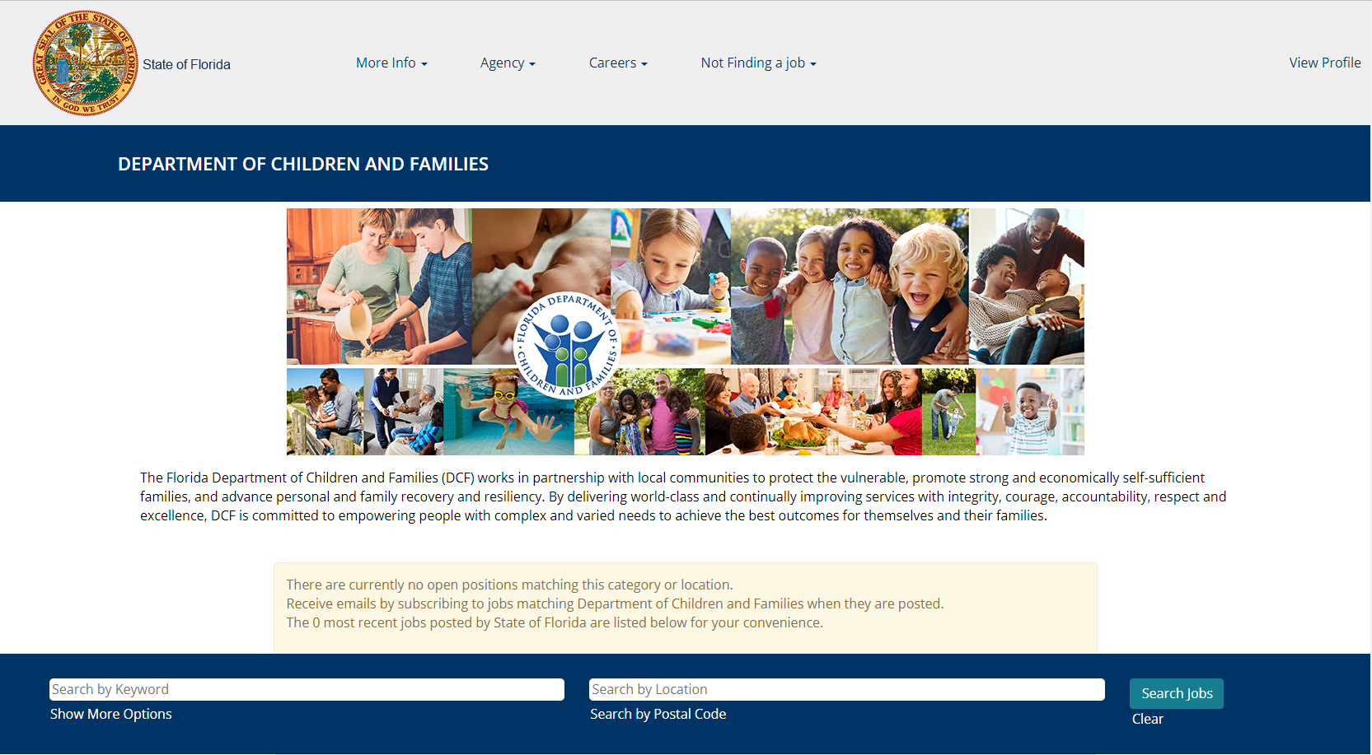
Search by Agency
Notes:
Agency pages allow candidates to view a brief description of the agency and view advertised jobs specific to that agency.

Slide 9
Search by Careers
Notes:
You may also search jobs by career opportunities. To do so, select the Careers dropdown and pick the career opportunity category you are interested in. When selected, open job advertisements that match the career type are listed.

Slide 10
Search by Careers
Notes:
By scrolling down on the Home page, the Career Opportunities section displays the same job types you will find in the Careers dropdown menu above. Select the picture tile to view open job advertisements for the career type selected.

Slide 11
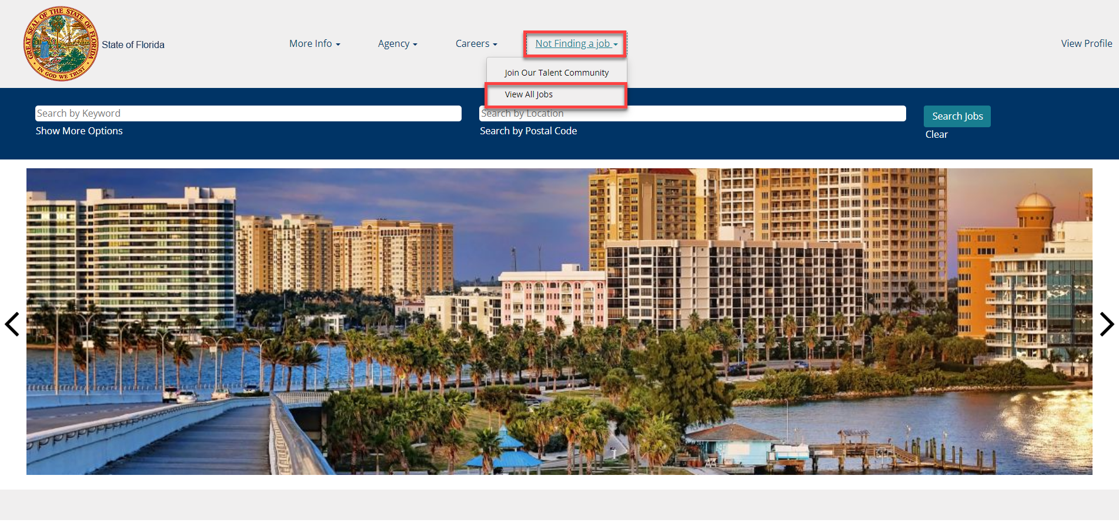
View All Jobs
Notes:
To view all jobs, select the Not Finding a Job option and select View All Jobs. This will display all advertised positions within the State of Florida.

Slide 12
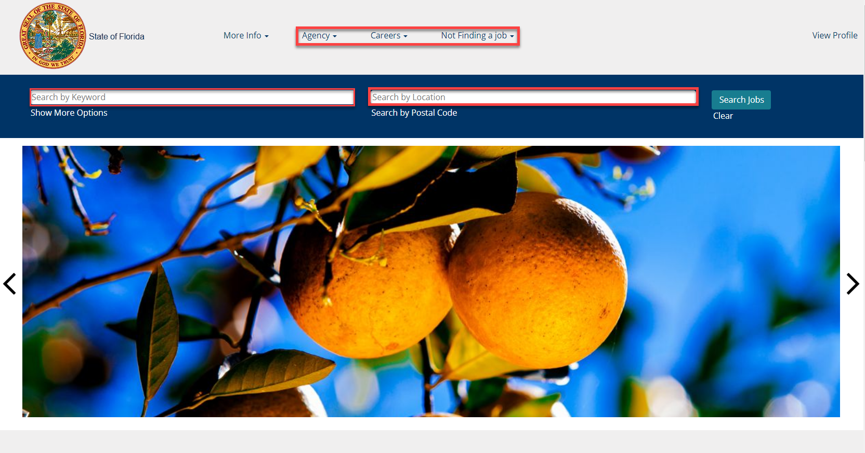
Search for a Job
Notes:
To narrow down your results, you may also search by keyword (e.g., analyst or director). A keyword search will retrieve all job advertisements that include the keyword in the title or description of the job vacancy.
In addition, searching by location (city or postal code) retrieves job vacancies specific to that location.
Important note: Not all job vacancies are advertised by location. If you are not finding the job you are looking for, try searching by View All Jobs, Agency, Careers or keyword.

Slide 13
Search for a Job
Notes:
Expand additional search filters by selecting Show More Options under the Search by Keyword field. Additional search options include Announcement Type ( Open Competitive / Internal) and City search.

Slide 14
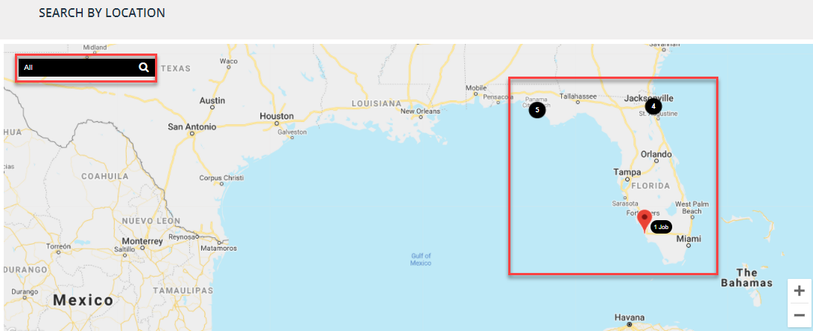
Search by Location
Notes:
From the bottom of the home page, you also have the option to search for jobs by geographical region. To see the job vacancies in a specific region, select the numbered circle for that region or use the search bar for a keyword search.

Slide 15
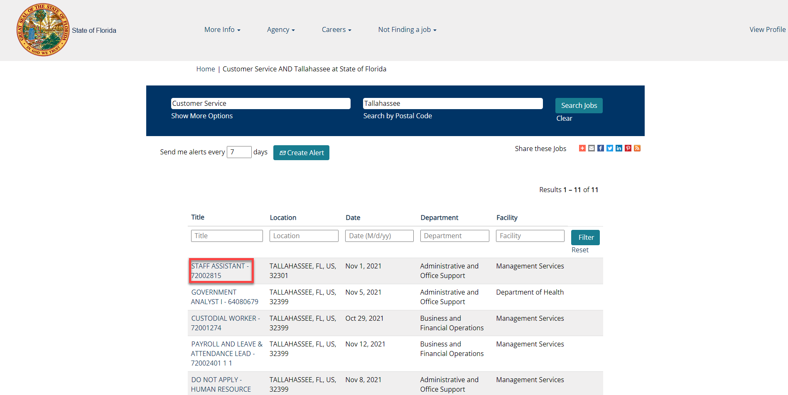
Search Results
Notes:
Using any of the above search options will display the open job advertisements based on your search. Select the job title to view the job description or to apply for the position.

Slide 16
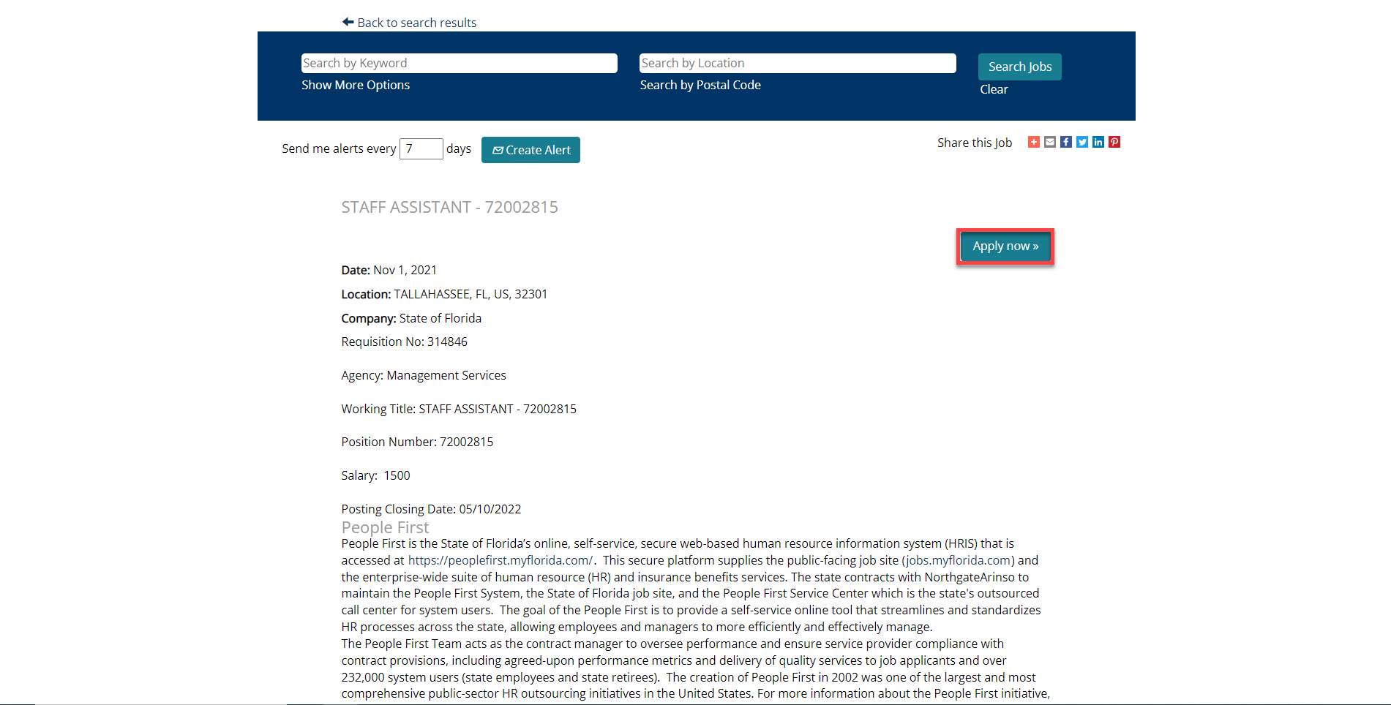
Job Details
Notes:
Here you can view the details of the job and can even start the job application process. To apply to the job, select the Apply Now button.

Slide 17
1. Searching Jobs
2. Creating Your Candidate Profile
3. Applying to a Job Vacancy
4. Managing Your Job Vacancy Submissions
Notes:
You have completed section 1, Searching Jobs. Let's move to section 2, Creating Your Candidate Profile.

Slide 18
CREATING YOUR CANDIDATE PROFILE
Notes:
We will now walk through the process of creating your candidate profile.

Slide 19
Create A Candidate Profile
Notes:
If you are not a registered candidate, select the Join Our Talent Community button to create an initial candidate profile and your job agents (keyword alerts).

Slide 20
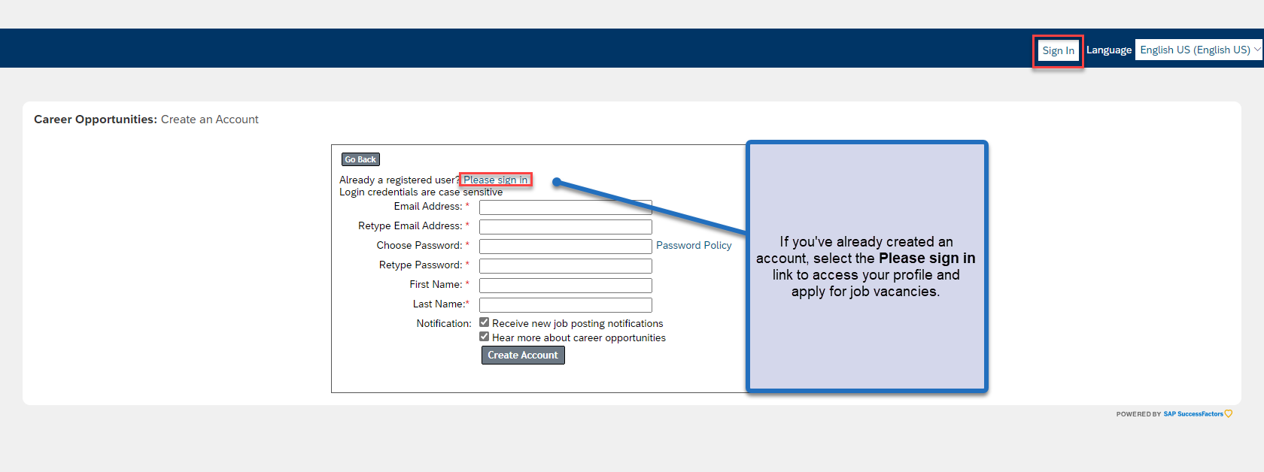
Create a Candidate Profile
Notes:
Complete all required fields when creating your candidate profile, including setting up agent searches (keyword alerts).

Slide 21
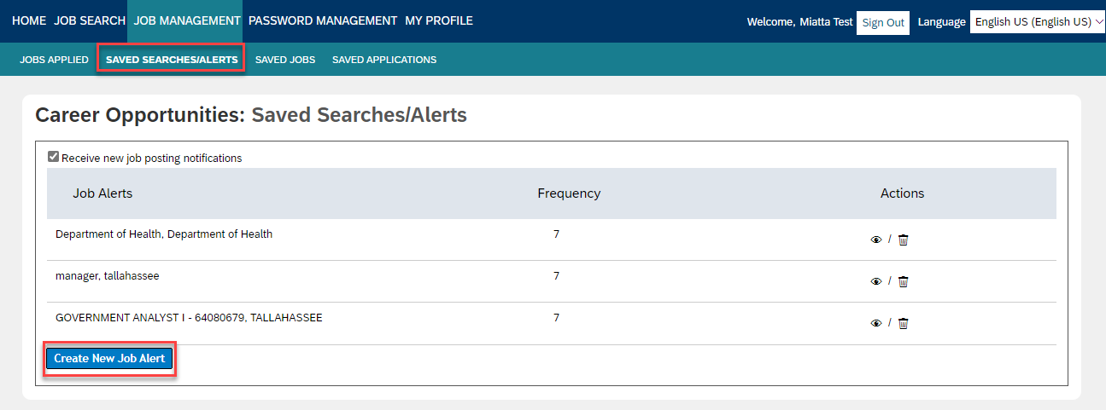
Create Job Alerts
Notes:
Select View Profile from the home page, if not already logged in, to access the Job Management screen. Here you can create alerts to notify you when a position is posted that includes the selected criteria like job type, location and postal code keywords. You can indicate how frequently you would like to be notified for each alert you create.

Slide 22
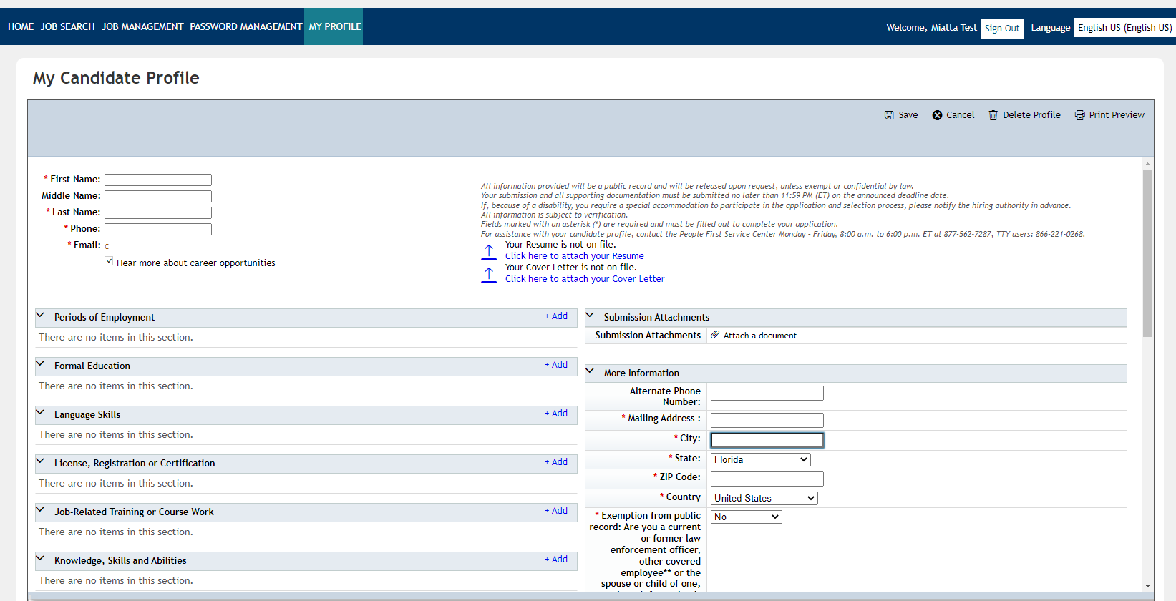
Candidate Profile
Notes:
The next few slides will review the Candidate Profile section which displays supporting documentation, jobs applied, and saved applications.

Slide 23
Candidate Profile – My Documents
Notes:
Attach resumes, a cover letter, or additional documents to submit with the application here. Select the Upload icon to choose a file and attach your resume; select Upload. If your resume is a Word document or similar format, portions of your resume will populate into the various Candidate Profile fields. Additionally, the system will save the resume within your profile for use when applying to future job vacancies.

Slide 24
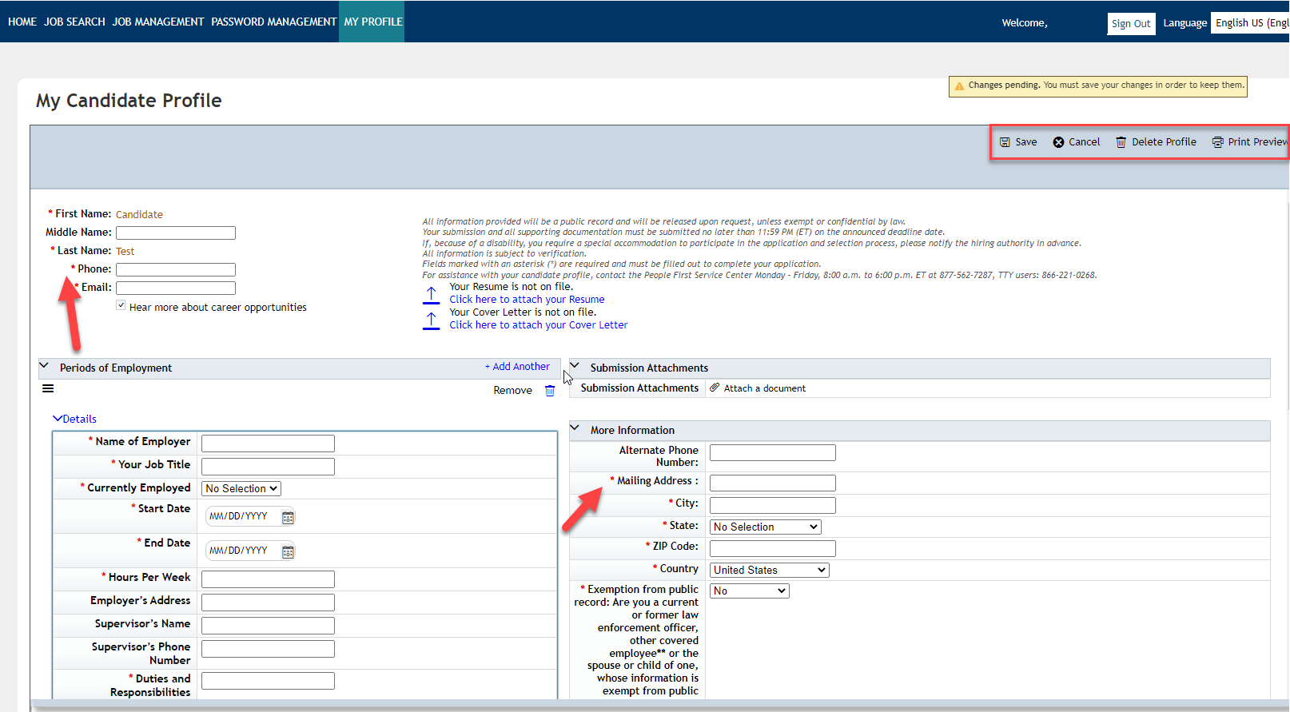
Candidate Profile – My Profile
Notes:
Update or enter your personal information in the required fields marked with a red asterisk (*).

Slide 25
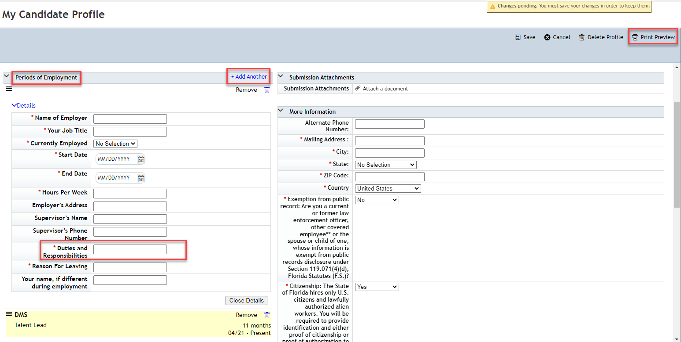
Candidate Profile – Periods of Employment
Notes:
Document past employment in the Periods of Employment section of the candidate profile. Data may have populated from uploading a resume. Review and update if necessary. To add additional employment, select the +Add Another icon.
Tip: Fields will only display 25 characters at a time. To get the full view of data in a field like Duties and Responsibilities, select Print Preview to view the full text. This is how the hiring office will see it. You can also copy and paste the information from the field into another document and edit if necessary.
Continue through the profile and update as needed. When complete, select the Save button at the top right of the page.

Slide 26
1. Searching Jobs
2. Creating Your Candidate Profile
3. Applying to a Job Vacancy
4. Managing Your Job Vacancy Submissions
Notes:
You have completed section 2, Creating Your Candidate Profile. Let's move to section 3, Applying to a Job Vacancy.

Slide 27
APPLYING TO A JOB VACANCY
Notes:
Now let’s explore how to apply to a job vacancy.

Slide 28
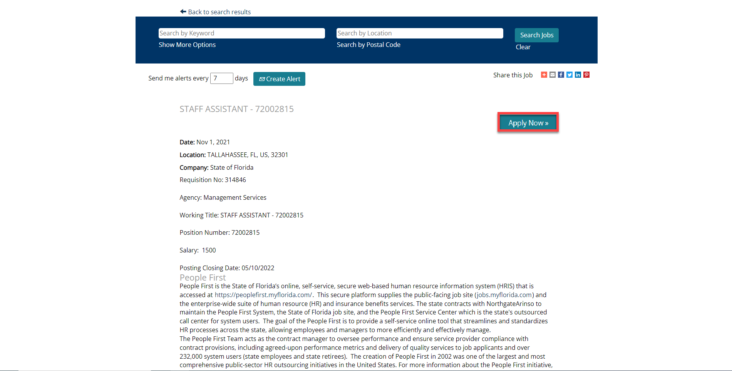
Applying to a Job Vacancy
Notes:
Once you have found a job you want to apply to, select Apply Now.

Slide 29
Applying to a Job Vacancy
Notes:
If you are not logged in, enter the email address and password you used to create your job site account and select the Sign In button.

Slide 30
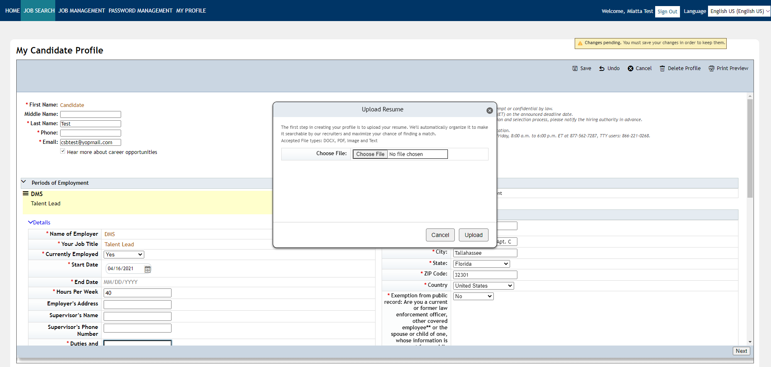
Applying to a Job Vacancy
Notes:
The application consists of sections from the candidate profile.
The Upload Resume window is presented to upload a resume for this job submission if not already attached. Please note that you are not required to attach a resume but doing so will make the application process easier.
Select the Choose File button to locate and upload your resume; select Upload. If your resume is a Word document or similar format, portions of your resume will populate into the various Candidate Profile fields.
Continue through each section to review or edit the candidate information that will be attached to this job submission. Required fields are marked with a red asterisk (*) and an error message will display when the Next button is selected and a required field is missing data.

Slide 31
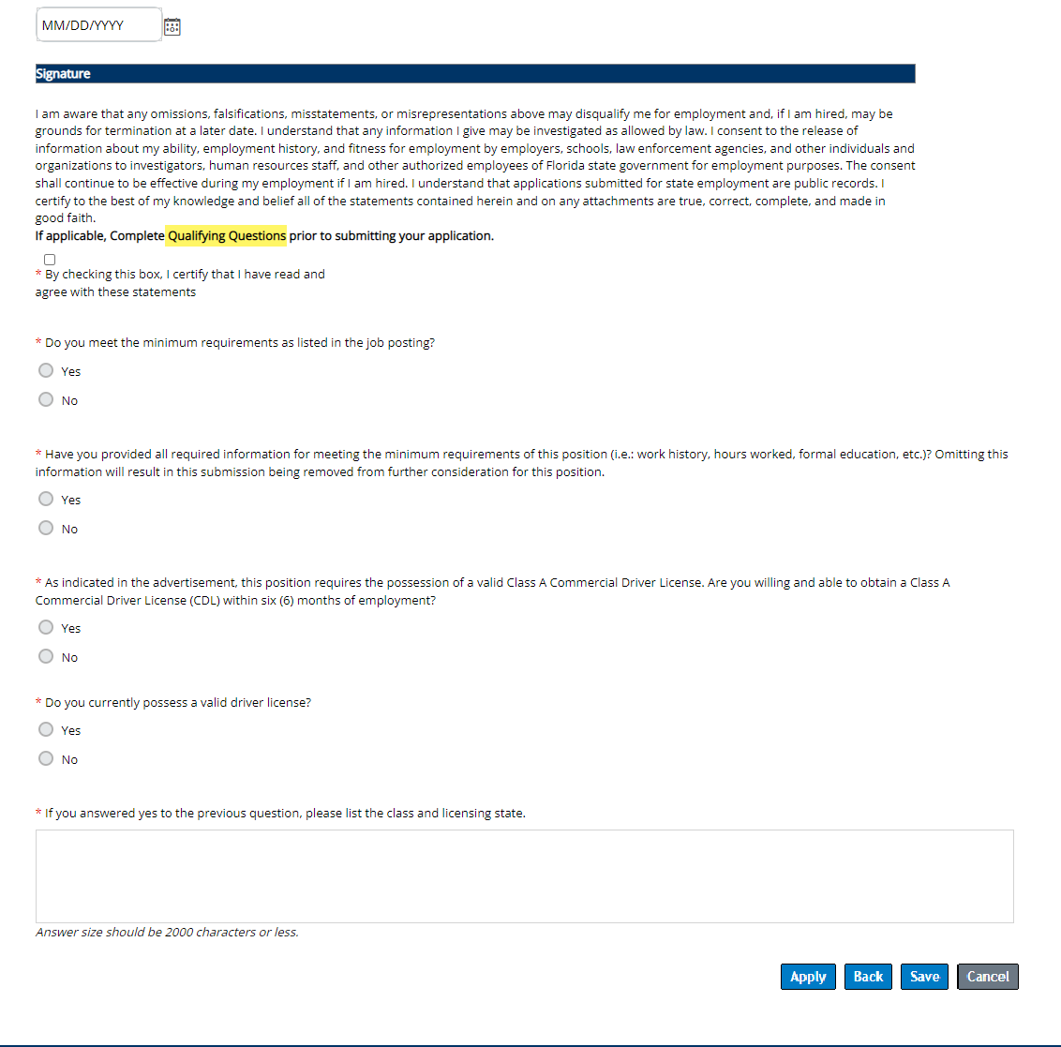
Applying to a Job Vacancy
Notes:
Most job vacancies will include Qualifying Questions that must be completed before applying. Once submitted, the answers or the application cannot be altered.

Slide 32
Applying to a Job Vacancy
Notes:
Once you have finalized your profile, complete your application by answering a series of qualifying questions related to the job vacancy. Please note that you may have to answer similar questions for each job vacancy you apply to. Once you have answered all questions, check the box to certify that all information included in your job submission is accurate and you have read and agree to all statements. Then select the Apply button. Please note that if you are unable to finish your application, you can select the Save button to complete your application later. Remember that you must complete your application prior to the job vacancy’s closing date.

Slide 33
Applying to a Job Vacancy
Notes:
Once you have successfully applied to a job vacancy, you will receive a confirmation message that your application has been sent and you will receive an email to your candidate profile email address.

Slide 34
1. Searching Jobs
2. Creating Your Candidate Profile
3. Applying to a Job Vacancy
4. Managing Your Job Vacancy Submissions
Notes:
You have completed section 3, Applying to a Job Vacancy. Let’s move to section 4, Managing Your Job Vacancy Submissions.

Slide 35
MANAGING YOUR JOB VACANCY SUBMISSIONS
Notes:
Now that you have applied to a job vacancy, let’s talk about managing your job vacancy submissions.

Slide 36
Manage Your Vacancy Submissions
Notes:
You can review jobs you successfully applied for under your profile in the Jobs Management section. The status of the vacancy and date of applicant submission is available.
You may review the submission by selecting the tile but please note that once you have submitted an application for a position, changes are not allowed, only the action to view profile or withdraw application is available.
Please note: Once you withdraw your application submission, you will not be able to re-apply to the same vacancy.

Slide 37
Manage Your Vacancy Submissions
Notes:
Should you find a job you wish to save to review or apply for later, you may save it by selecting the Save button and at the bottom of the vacancy.
Saving a job does not submit the candidate application for review, only saves to your profile for quick access.

Slide 38
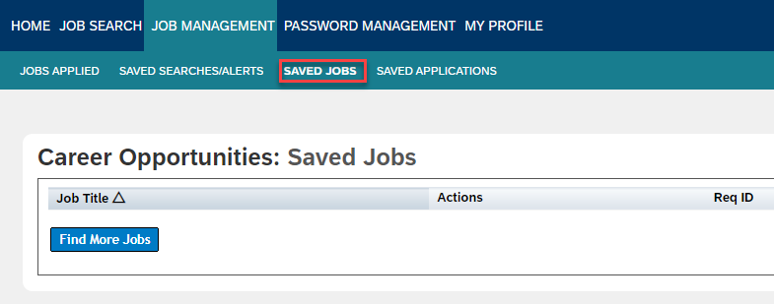
Manage your Job Vacancy Submissions
Notes:
You can review your saved jobs from your profile.
Note: Saved jobs would need to be successfully submitted before the advertisement closes. Open positions are removed from the site at 11:59 p.m. of the closing date.

Slide 39
UNDERSTANDING WHAT TO EXPECT AFTER APPLYING
Notes:
Now that you have applied to a job vacancy, let’s discuss what you can expect next. The hiring agency will review your submission and determine if your qualifications meet the job requirements.
Please be advised that People First is the system used to collect candidate submissions for the hiring agency. As such, the People First Service Center does not have any influence on the hiring process, as each state agency assumes the responsibility for its recruitment, selection and hiring decisions. If interested, the hiring agency will contact you directly regarding your submitted application.

Slide 40
1. Searching Jobs
2. Creating Your Candidate Profile
3. Applying to a Job Vacancy
4. Managing Your Job Vacancy Submissions
Notes:
During this presentation, we covered the following topics:
Searching Jobs
Creating Your Candidate Profile
Applying to a Job Vacancy
Managing Your Job Vacancy Submissions
Thank you for taking time to explore this system.

