Slide 1
Key findings of World Population Prospects 2022
Presentation by
Mr. John Wilmoth
Director, Population Division, UN DESA
“Global launch of World Population Prospects 2022, release of the latest China Population Prospects and symposium on low fertility”
12 July 2022, 8:30 a.m. - 12 noon, Beijing, China

Slide 2
WPP Workflow
2
Start
Censues, surveys, vital registers
Benchmark populations
by age and sex (t₀)
1
Estimate fertility, mortality, migration for the period (t₀₋₁)
4
Adjust benchmark population
if necessary
Re-estimate fertility,mortality, migration for period (t₀₋₁)
Run cohort component projection for period (t₀₋₁)
No match
3
Compare projection result with benchmark population by age and sex in (t₁)
Match
Proceed to next period (t₁₋₂)
Estimate net migration for period (t₀₋₁)
Benchmark population by age and sex (t₁)

Slide 3
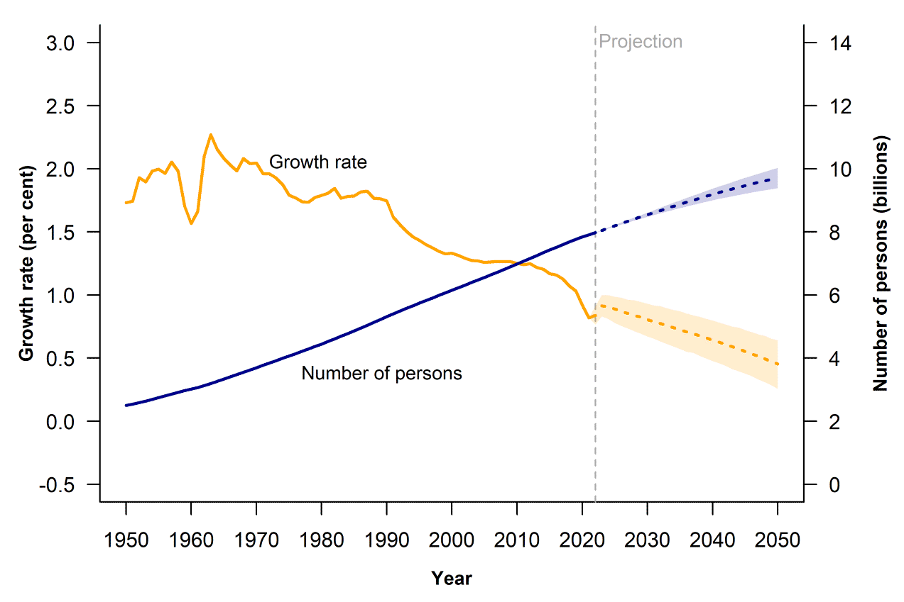
Global population size and annual growth rate: estimates, 1950-2022, and medium projection with 95 per cent prediction intervals, 2022-2050
From an estimated 2.5 billion people in 1950, the global population has grown more than threefold; by mid-November, it will reach 8 billion
The pace of growth is slowing down; in 2020, the global growth rate fell under 1 per cent per year for the first time since 1950

Slide 4
Total fertility rate by country or area, 2021
Today, two-thirds of the global population lives in a country or area where lifetime fertility is below 2.1 births per woman (roughly, the level required for zero growth in the long run for a population with low mortality)

Slide 5
Global population size: estimates, 1950-2022, and medium projection with 80 & 95 per cent prediction intervals, 2022-2100
The global population could number around 9.7 billion in 2050 and 10.4 billion by 2100
There is a relatively high degree of certainty about the projections for 2050, because more than half of the people who will be alive in that year have already been born
For 2100, however, the range of plausible outcomes is much wider

Slide 6
Countries ranked by contribution to projected global population growth between 2022 and 2050, according to the medium projection
More than half of the projected increase in the global population up to 2050 will be concentrated in eight countries: the Democratic Republic of the Congo, Egypt, Ethiopia, India, Nigeria, Pakistan, the Philippines and the United Republic of Tanzania

Slide 7
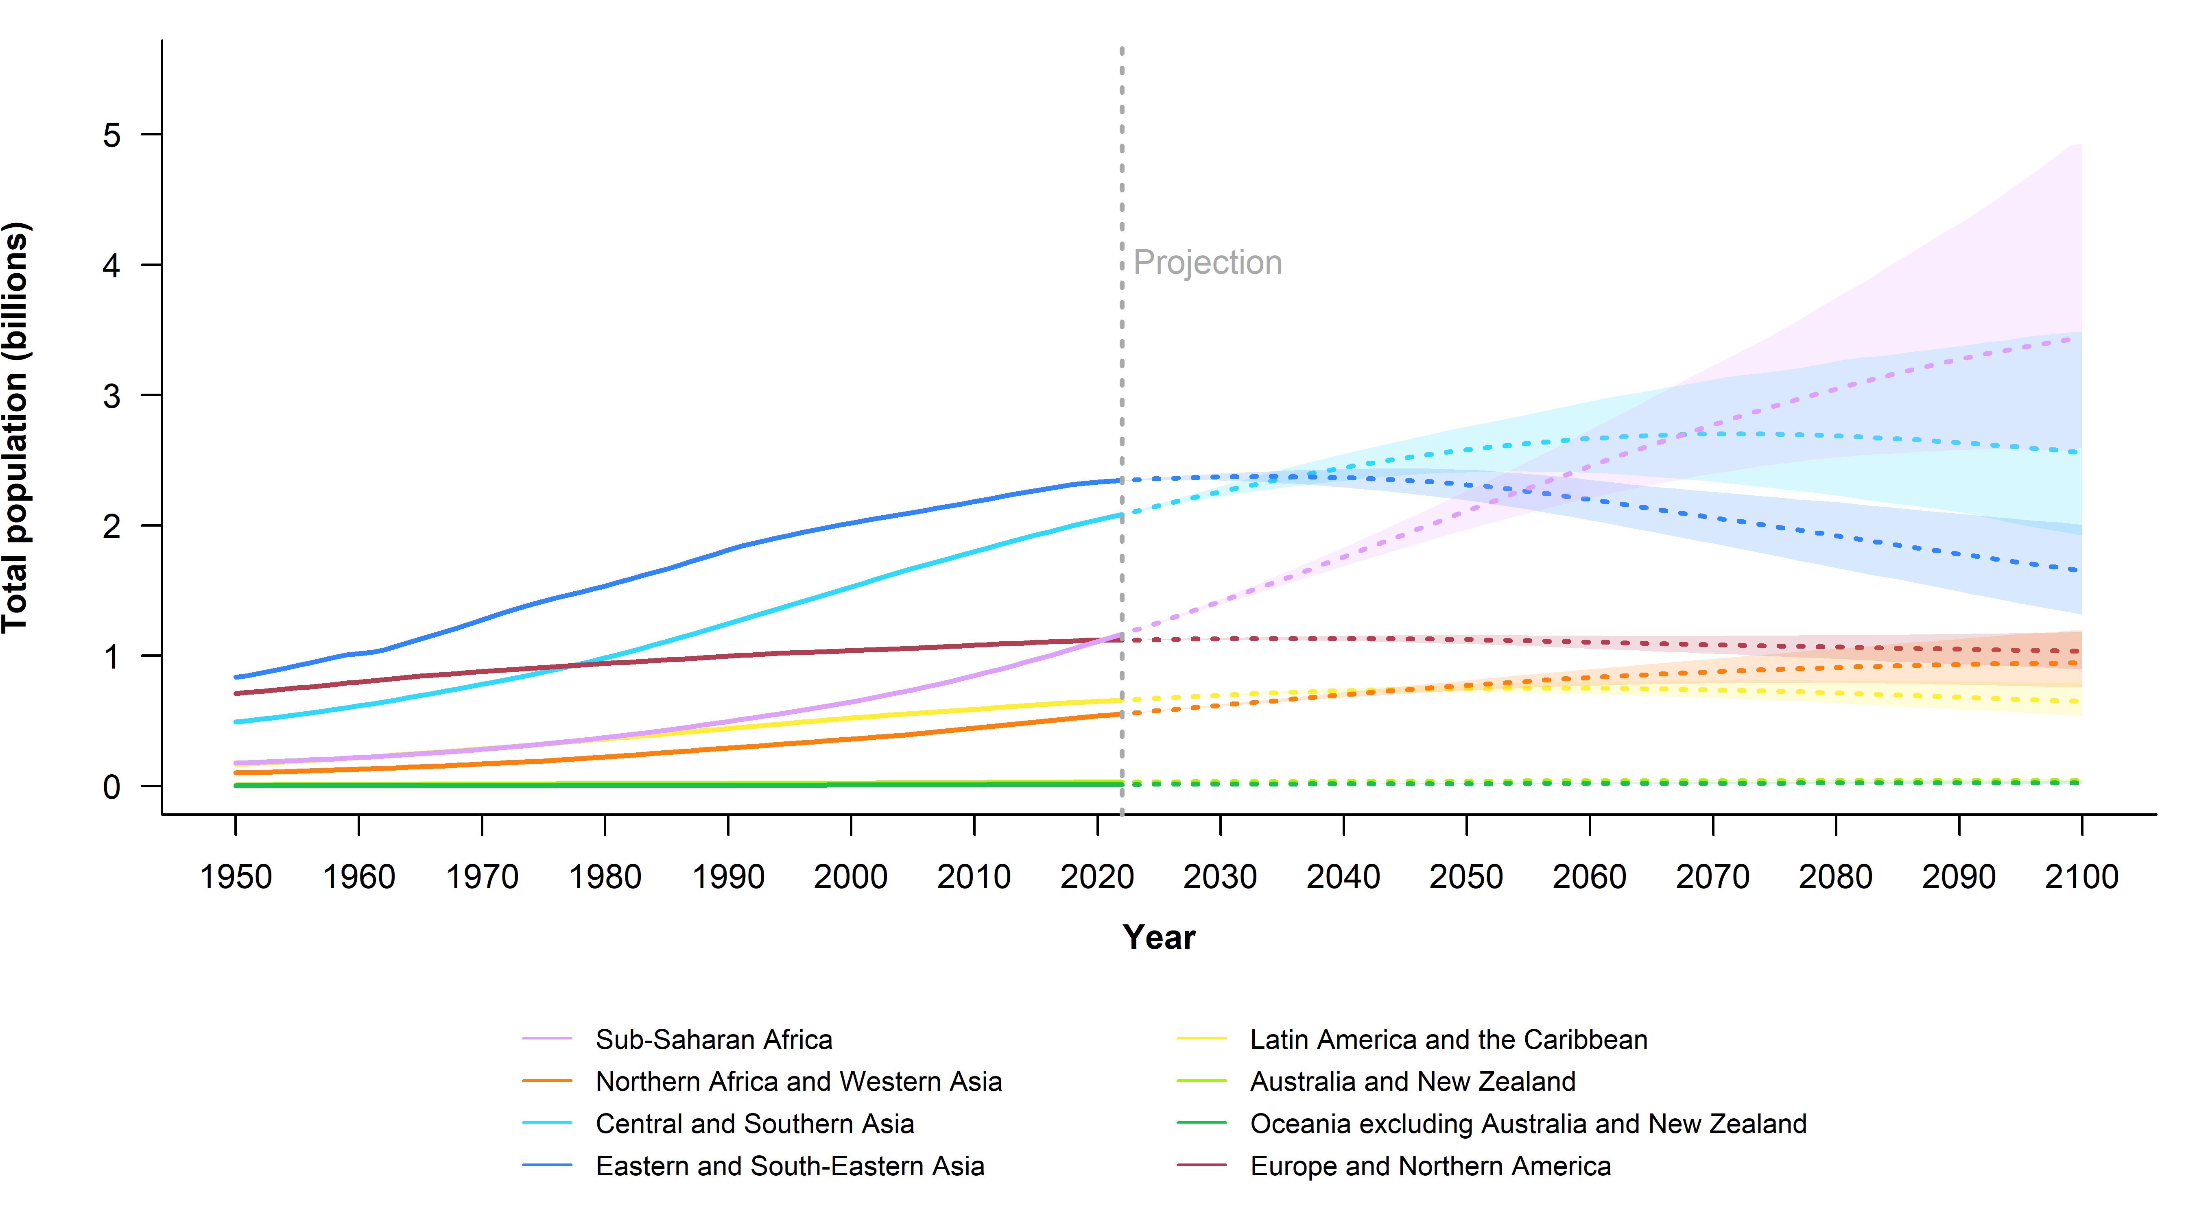
Population by SDG region: estimates, 1950-2022, and medium projection with 95 per cent prediction intervals, 2022-2100
Sub-Saharan Africa
The region of sub‑Saharan Africa is expected to continue growing through 2100 and to contribute more than half of the global population increase anticipated through 2050
Europe & Northern America
Eastern and South-Eastern Asia
Central and Southern Asia

Slide 8
Projected size of the world’s population, medium projection and momentum scenario, 2022-2100
Two-thirds of the projected increase in global population through 2050 will be driven by the momentum of past growth, which is embedded in the youthful age structure of the current population

Slide 9
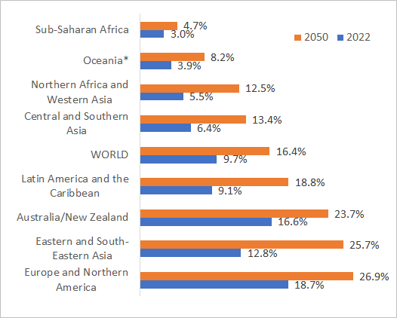
Share of the population aged 65 years or above by SDG region, 2022 and 2050
The world’s population will experience unprecedented ageing in the coming decades
The share of global population at ages 65 and above is projected to rise from 10 per cent in 2022 to 16 per cent in 2050
In several SDG regions, the share of older persons is projected to more than double between now and 2050
By 2050, one in four persons living in Europe or Northern America will be aged 65 or higher

Slide 10
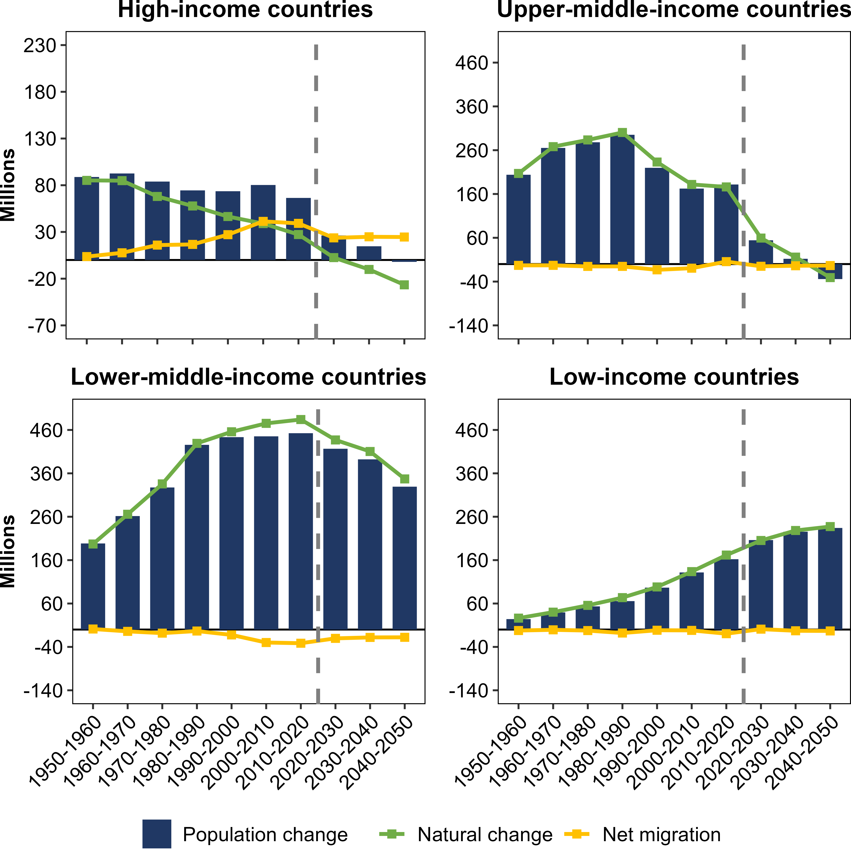
Two components of total population change, by income group, from 1950-1960 to 2040-2050
Over the next few decades, migration will become the sole driver of population growth in high-income countries
For the foreseeable future, population increase in low-income and lower-middle-income countries will continue to be driven by a substantial excess of births over deaths, typically much larger than the net outflow of migrants
Births minus deaths
Immigrants minus emigrants
Births minus deaths
Immigrants minus emigrants

Slide 11
The End

